Slide 1
Strategic Park Spending for Pawnee
Gabriel Toscano Analyst September, 2024

Slide 2
Agenda
National Trends in Park Spending
Changes in Spending From 2012
Cities with the Most and Least Park Spending
Comparing Spending to Coverage
Q&A and Contact Information

Slide 3
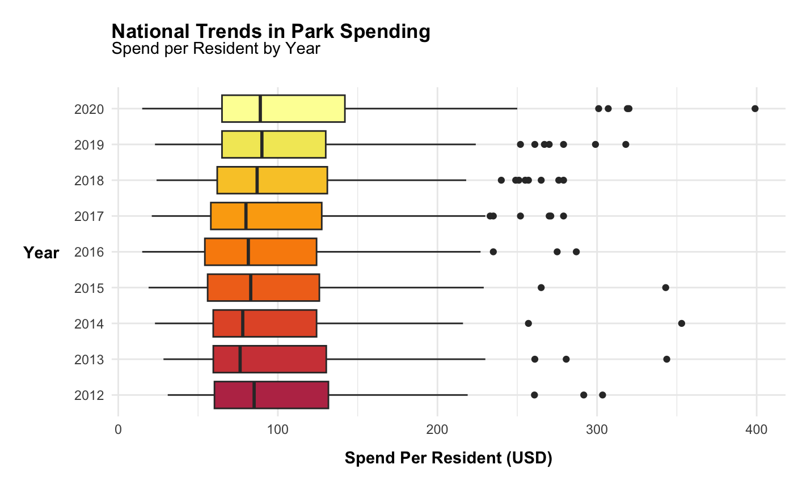
The national average for park spending gradually increased from 2017 onwards
The outlier cities spent more than ever in 2020
2

Slide 4
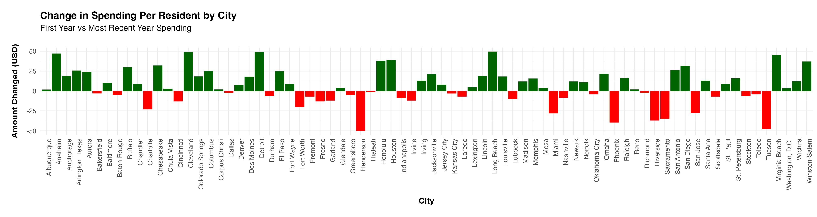
Looking at the difference between 2012 and the most recent year, there are big swings
Largest increases in
Long Beach
Cleveland
Detroit
Anaheim
Houston
Largest decreases in
Henderson
Tucson
Phoenix
Riverside
Sacramento
1

Slide 5
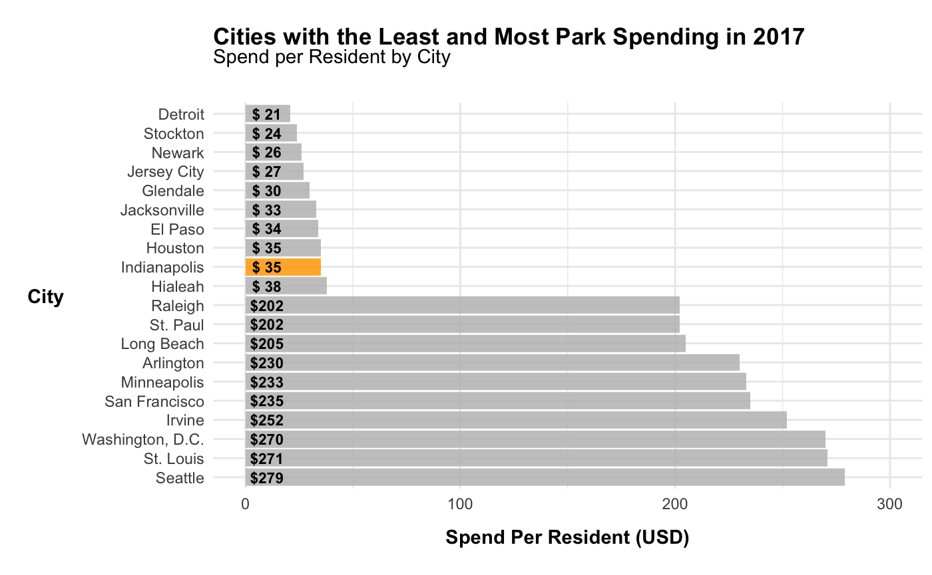
Indianapolis is among the lowest spenders in the country
The gap between the bottom 10 spenders and the top 10 spenders is over $150 per resident
3

Slide 6
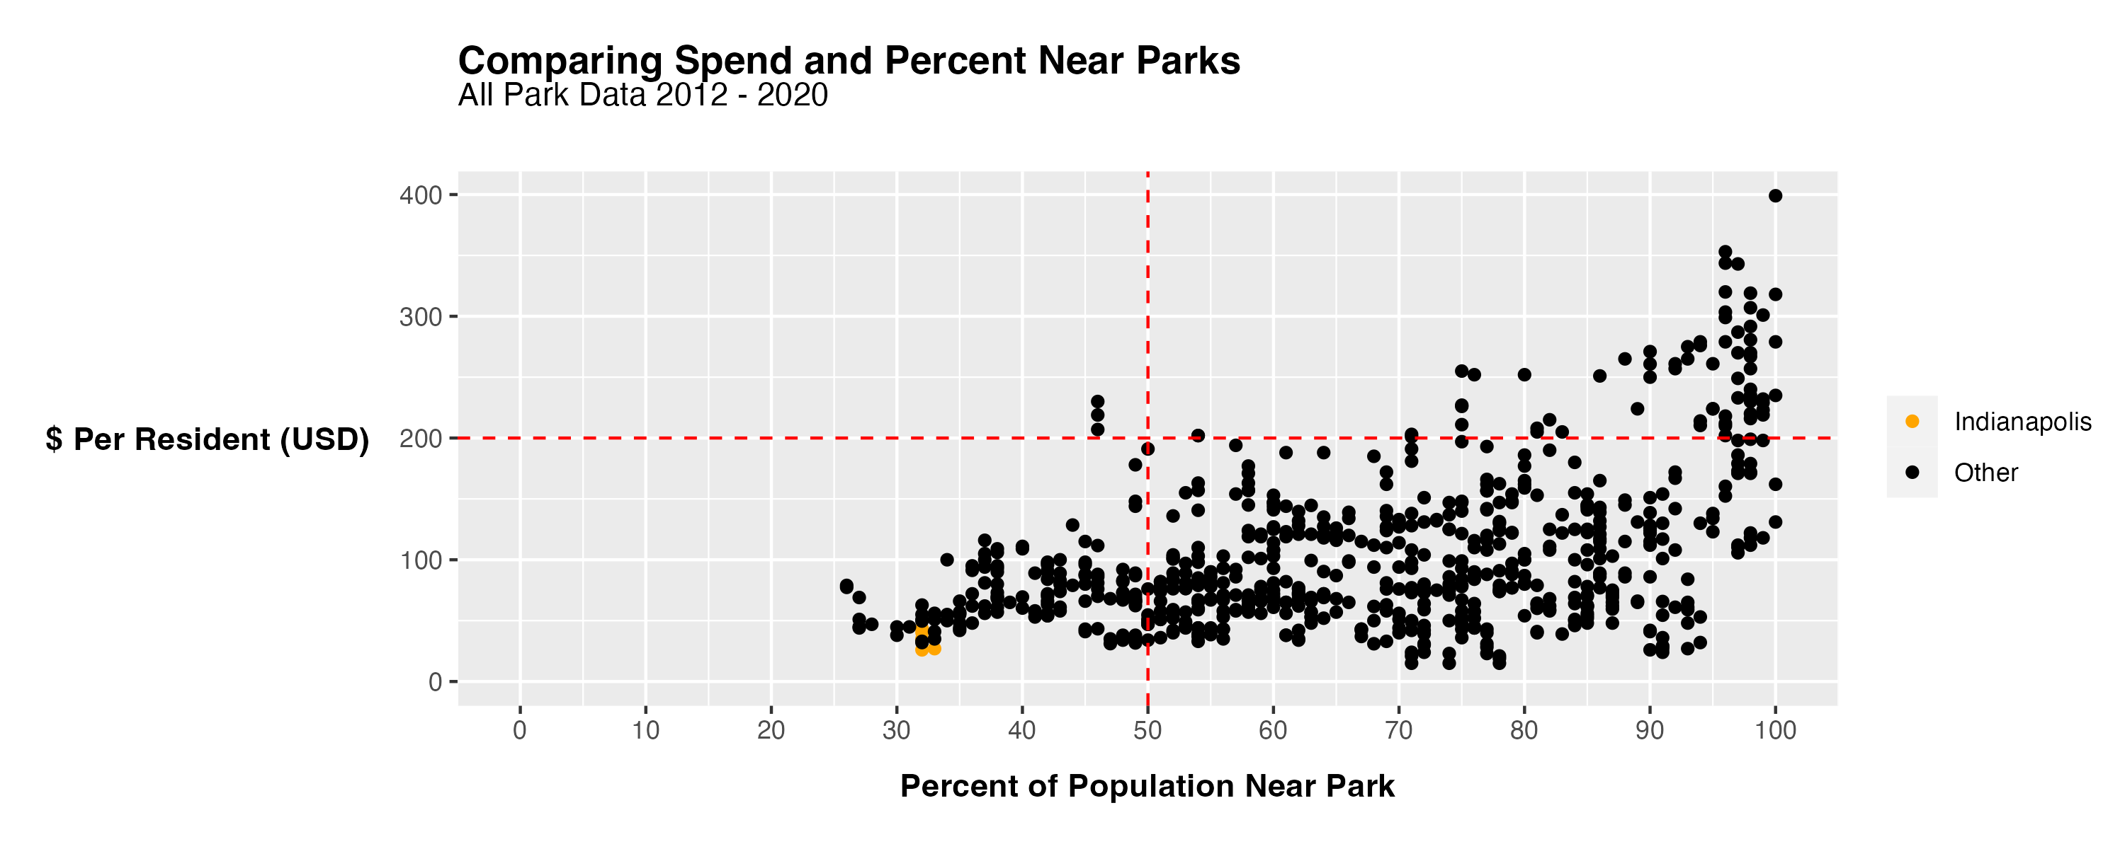
Indianapolis is a among the lowest spenders and has some of the lowest coverage in terms of percent of population near a park
5

Slide 7
High spend
Low Coverage
High spend
High coverage
Low spend
Low coverage
Low spend
High coverage
A large portion of the cities are able to provide 80% or more coverage at the same level of spending per resident as Indianapolis
5

Slide 8
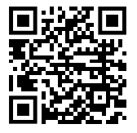
Thank you!
Gabriel Toscano
gabriel.toscano@duke.edu
linkedin.com/gabriel-toscano/

